Slide 1




Slide 2
Transposition Cipher
Given:
  Letter locations
  Plain text
  Key pattern
Example
  Plaint Text:
    SACK GAUL SPARE NO ONE
  Key Pattern:
    1->4, 2->8, 3->1, 4->5, 5->7, 6->2, 7->6, 8->3
Principles of Information Security, 3rd edition

Slide 3

Caesar Block Cipher
Principles of Information Security, 3rd edition

Slide 4
Cipher Methods (continued)
Exclusive OR (XOR): function of Boolean algebra; two bits are compared
  If two bits are identical, result is binary 0
  If two bits not identical, result is binary 1
Principles of Information Security, 3rd edition
Notes:
Transposition Cipher Method
The transposition cipher (or permutation cipher) simply rearranges the values within a block to create the ciphertext
This can be done at the bit level or at the byte (character) level. Transposition ciphers move these bits or bytes to another location in the block, so that bit 1 becomes bit 4, bit 2 becomes bit, 7 etc.

Slide 5
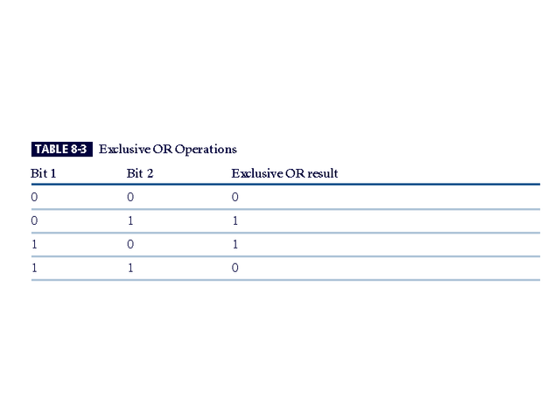
Table 8-1 Exclusive OR Operations
Perform an XOR cipher on the following bits.
Message 01100001 01100010 01100011
Cypher Key 01111111 01111111 01111111
Principles of Information Security, 3rd edition

Slide 6
01100001 = a
01100010 = b
01100011 = c
Message 01100001 01100010 01100011
Key 01111111 01111111 01111111
Cypher text 00011110 00011101 00011100
Principles of Information Security, 3rd edition

Slide 7
Principles of Information Security, 3rd edition

